Slide 1
DSEM

Slide 2
DSEM usage
Rceattle is integrated with DSEM via the fit_mod function argument dsem = build_DSEM.

Slide 3
build_DSEM arguments
sem Specification for time-series structural equation model structured
All variables must be included in env_data
The default is assumes IID recruitment deviates.
If no start value is provided, those model terms are not estimated. CHANGE???
family distribution used for each variable (can be length 1)
all_vars include all variables from env_data in DSEM model likelihood (estimate observation error)
Allow model comparison across different SEM when TRUE.
Simplifies estimation when FALSE
estimate_projection latent variables for projection time period are turned off
Simplifies estimation when FALSE

Slide 4
Default example: GOA pollock, IID recruitment
library(Rceattle) data("GOApollock") # Single-species data. ?BS2017SS for more information on the data GOApollock$projyr <- 2020 # Shorten proj year for quicker estimation GOApollock$env_data <- GOApollock$env_data %>% dplyr::mutate(ScaledBT =scale(BTempC)) %>% dplyr::select(-BTempC) model1 <- Rceattle::fit_mod(data_list = GOApollock, random_rec = TRUE, # Random recruitment verbose = 0)
[1] "'Age_max_selected_upper' not specified in 'fleet_control', assuming 'NA'" [1] "'Sel_curve_pen1' not specified in 'fleet_control', assuming '0'" [1] "'Sel_curve_pen2' not specified in 'fleet_control', assuming '0'" [1] "Selectivity for Pollock_survey_1_shelikof_acoustic, Pollock_survey_1_shelikof_acoustic_BS is mirrored with another fleet"
print(model1$data_list$dsem_settings$sem)
[1] "recdevs1 <-> recdevs1, 0, sigmaR1, 1\n"

Slide 5
View SEM
print(model1$data_list$dsem_settings$sem)
[1] "recdevs1 <-> recdevs1, 0, sigmaR1, 1\n"

Slide 6
View parameter estimates
# mu_j, lnsigma_j, delta0_j, x_tj print(model1$estimated_params$beta_z)
1 2 1.393147 1.000000

Slide 7
path | lag | name | start | parameter | first | second | direction | Estimate
recdevs1 <-> recdevs1 | 0 | sigmaR1 | 1 | 1 | recdevs1 | recdevs1 | 2 | 1
ScaledBT <-> ScaledBT | 0 | V[ScaledBT] | NA | 2 | ScaledBT | ScaledBT | 2 | 1
Query dsem object
class(model1$dsem)
[1] "dsem"
knitr::kable(summary(model1$dsem)) # need to figure out updating pars

Slide 8
SEM example
sem_iid = " # link, lag, param_name, start_value #internal data relation ScaledBT -> ScaledBT, 1, AR_BT, 0 ScaledBT -> recdevs1, 1, BT_to_R, 0 recdevs1 <-> recdevs1, 0, sigmaR1, 1 " model2 <- Rceattle::fit_mod(data_list = GOApollock, dsem = build_DSEM( sem = sem_iid, family = "normal" ), random_rec = TRUE, # Random recruitment verbose = 0)
[1] "'Age_max_selected_upper' not specified in 'fleet_control', assuming 'NA'" [1] "'Sel_curve_pen1' not specified in 'fleet_control', assuming '0'" [1] "'Sel_curve_pen2' not specified in 'fleet_control', assuming '0'" [1] "Selectivity for Pollock_survey_1_shelikof_acoustic, Pollock_survey_1_shelikof_acoustic_BS is mirrored with another fleet"

Slide 9
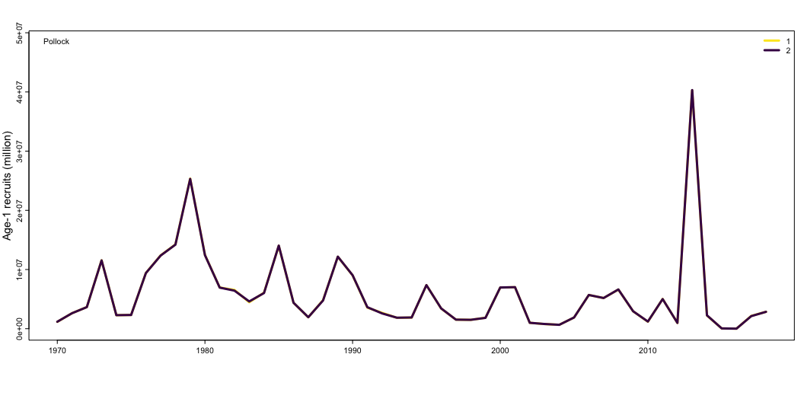
Plot: looks same?
plot_recruitment(list(model1, model2), model_names = 1:2)

Slide 10
path | lag | name | start | parameter | first | second | direction | Estimate
recdevs1 <-> recdevs1 | 0 | sigmaR1 | 1 | 1 | recdevs1 | recdevs1 | 2 | 1.393147
ScaledBT <-> ScaledBT | 0 | V[ScaledBT] | NA | 2 | ScaledBT | ScaledBT | 2 | 1.000000
Query
summ <- summary(model1$dsem) summ$Estimate <- model1$estimated_params$beta_z knitr::kable(summ)

Slide 11
path | lag | name | start | parameter | first | second | direction | Estimate
ScaledBT -> ScaledBT | 1 | AR_BT | 0 | 1 | ScaledBT | ScaledBT | 1 | 0.05231416
ScaledBT -> recdevs1 | 1 | BT_to_R | 0 | 2 | ScaledBT | recdevs1 | 1 | -0.35799269
recdevs1 <-> recdevs1 | 0 | sigmaR1 | 1 | 3 | recdevs1 | recdevs1 | 2 | 1.35698839
ScaledBT <-> ScaledBT | 0 | V[ScaledBT] | NA | 4 | ScaledBT | ScaledBT | 2 | 1.00000000
summ <- summary(model2$dsem) summ$Estimate <- model2$estimated_params$beta_z knitr::kable(summ)

